Slide 1

Homework 3 Firewall INT4023
Dalton Murray

Slide 2
FTP Connection

Slide 3
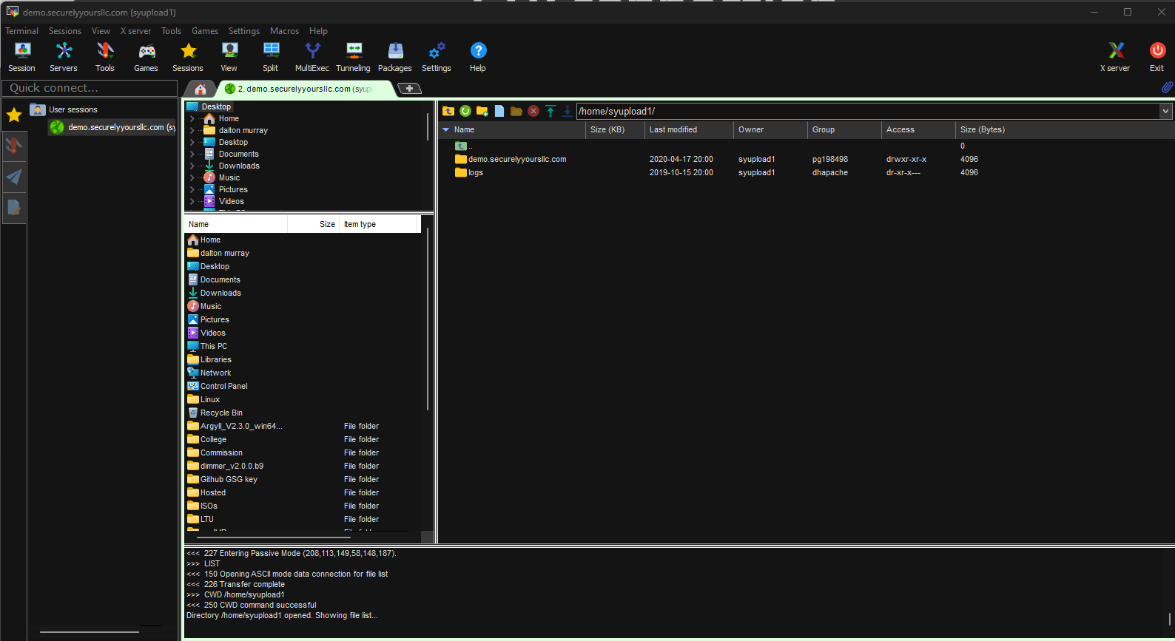
FTP Connection – Firewall unblocked
Using a VPN using my preferred FTP client I can make a connection to demo.securelyyoursllc.com, without any firewall blocking it

Slide 4
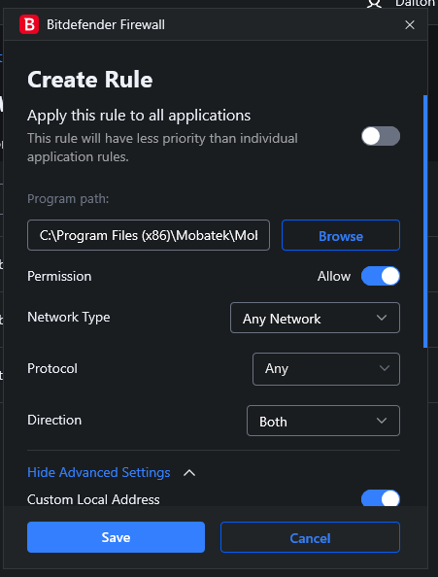
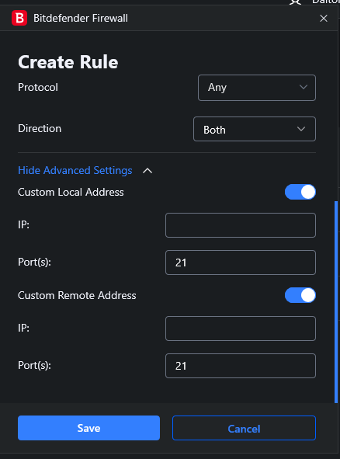
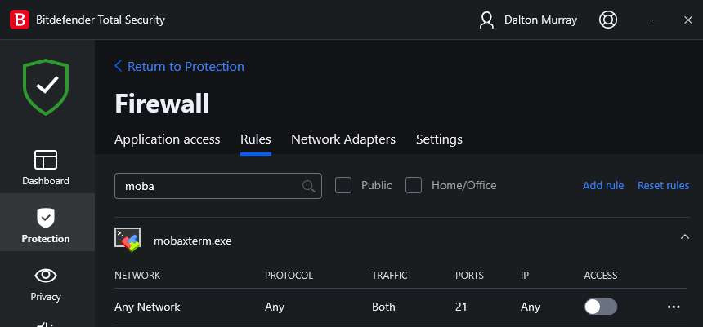
Firewall configuration
I use Bitdefender on my personal computer among other antivirus and other countermeasures, this is showing how I can choose a program and then specify port 21 to then block its outgoing and incoming connections

Slide 5
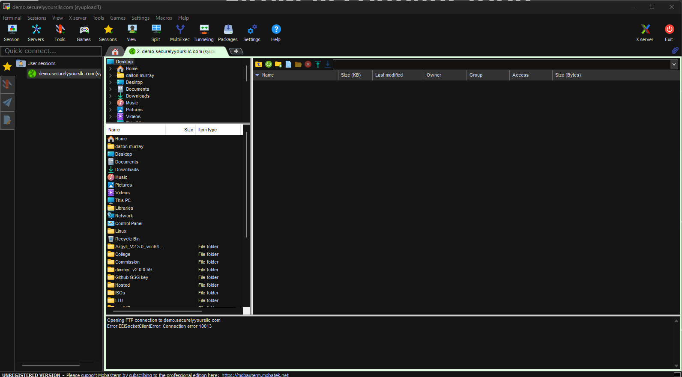
FTP Connection – Firewall blocked
This now shows that I am getting a socket error connecting to demo.securelyyoursllc.com, error 10013, which is a general error for a blocked connection

Slide 6
Website Connection

Slide 7
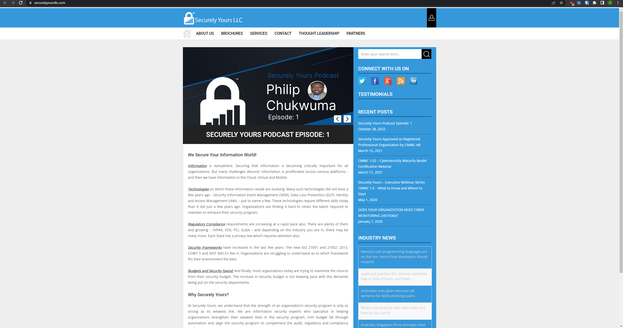
Website Connection – Firewall unblocked
I am able to make a connection to securelyyoursllc.com with no blocks put in place

Slide 8
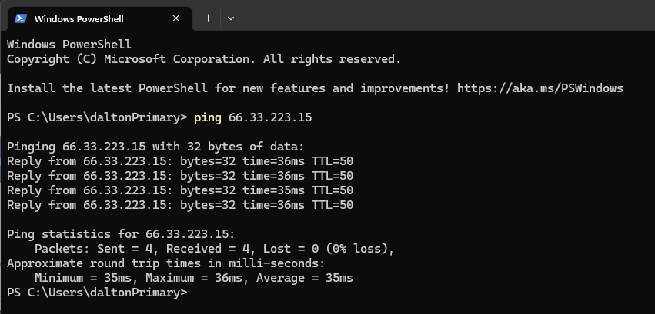
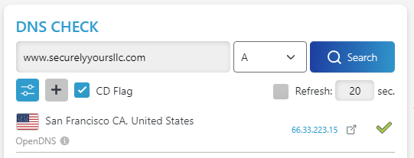
Finding the IP & Pinging it
This shows that the IP for seclureyoursllc.com is 66.33.223.15, which I am able to ping and get a response back

Slide 9
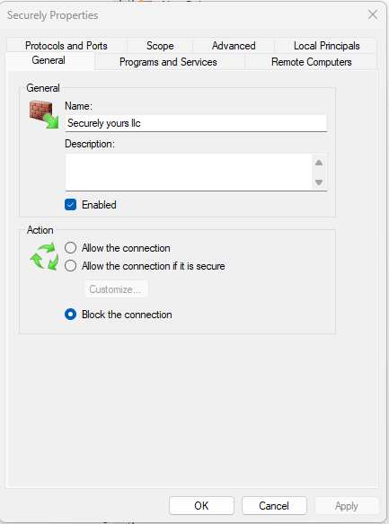
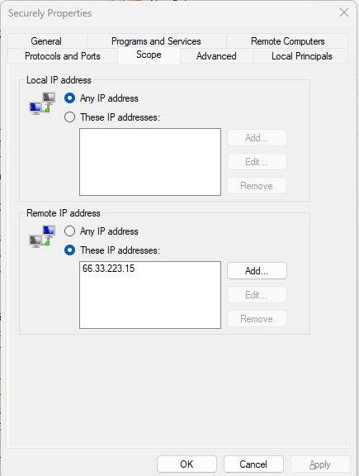
Blocking the IP
Unable to properly do with Bitdefender firewall because of existing overrides that can’t be disabled without causing problems, switched to Windows firewall and blocked 66.33.223.15 both inbound and outbound

Slide 10
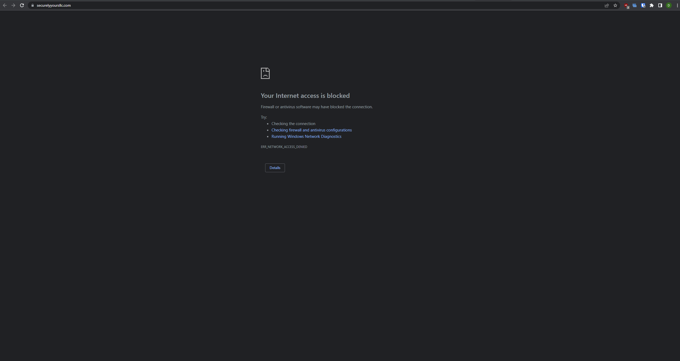
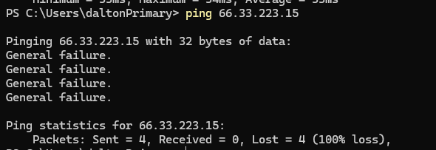
Connection – Firewall blocked
Website and all connections to the IP are blocked

